Slide 1
CREATE TABLE IN HANA.
Milind Parab

Slide 2
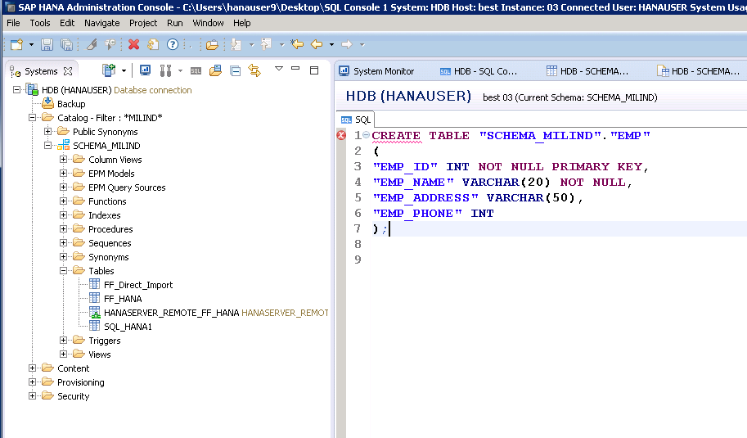
Create Table in HANA.

Slide 3
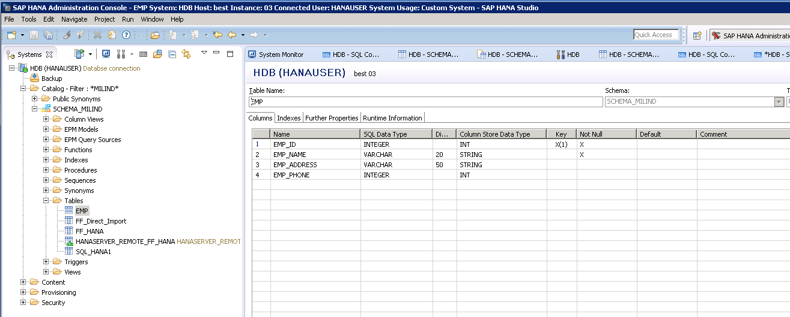
Table has been created.

Slide 4
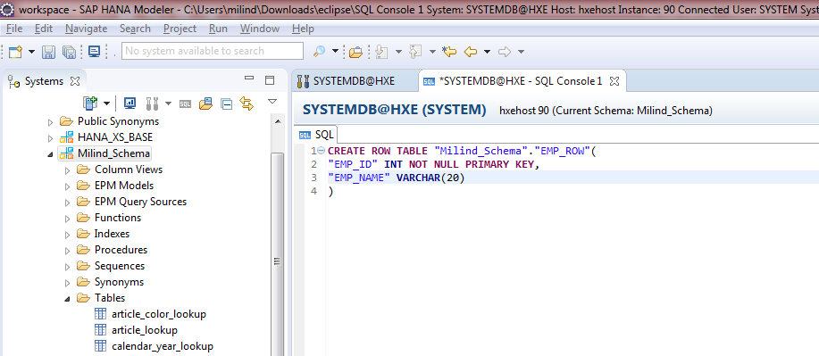
Create Row Table.

Slide 5
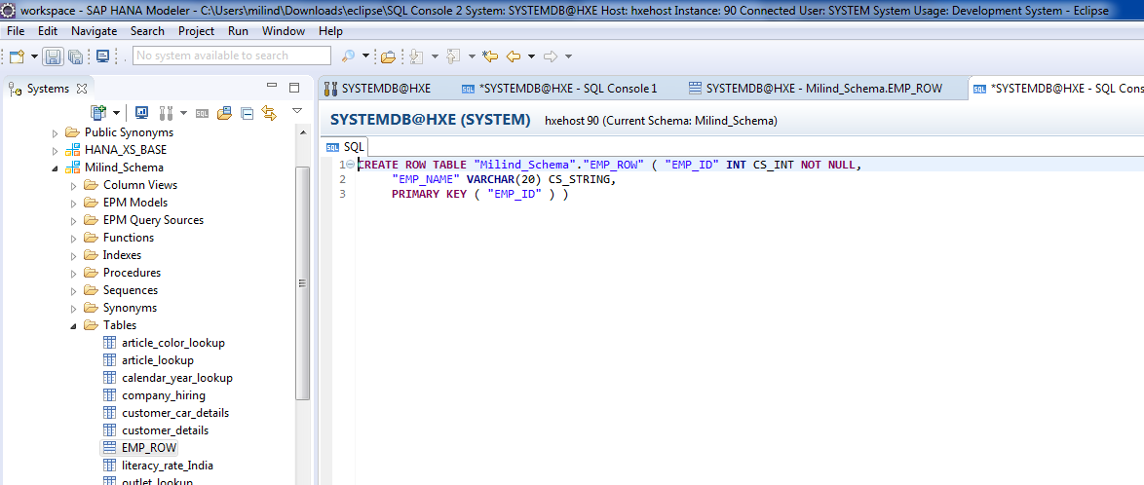
There is no unload priority or Auto Merge in Row Table.

Slide 6
ALTER TABLE.
Milind Parab

Slide 7
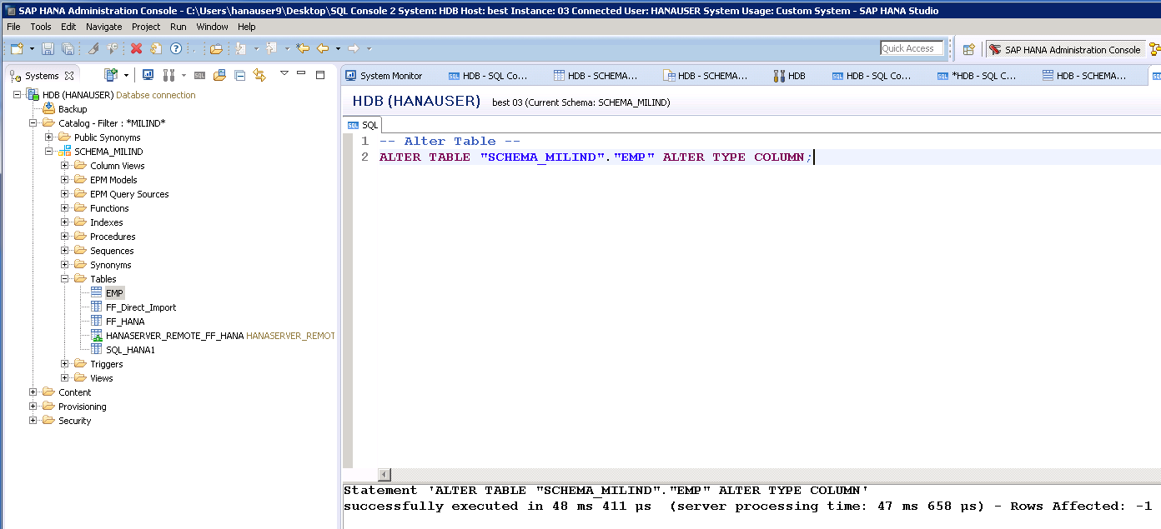
Alter Table Type.

Slide 8
Insert values.
Milind Parab

Slide 9
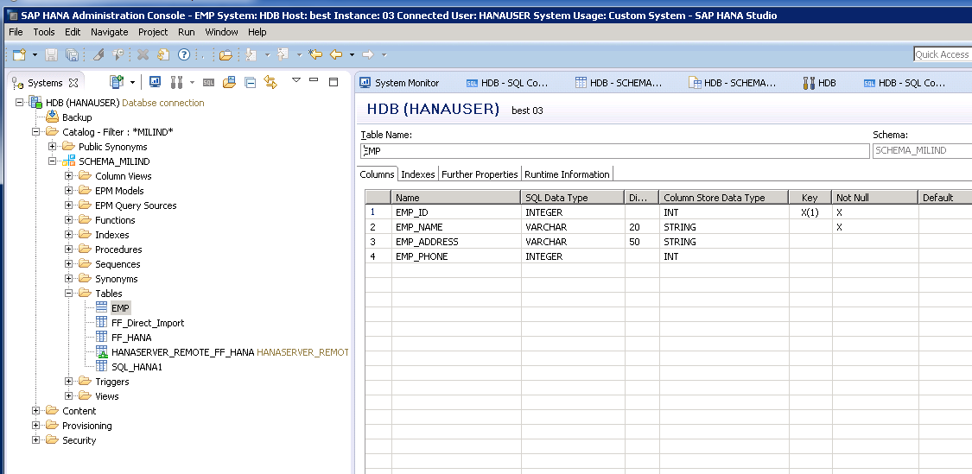
Table definition.

Slide 10
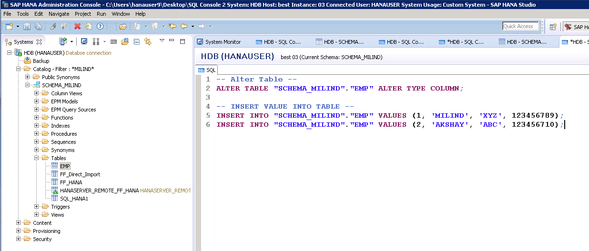
Cont.

Slide 11
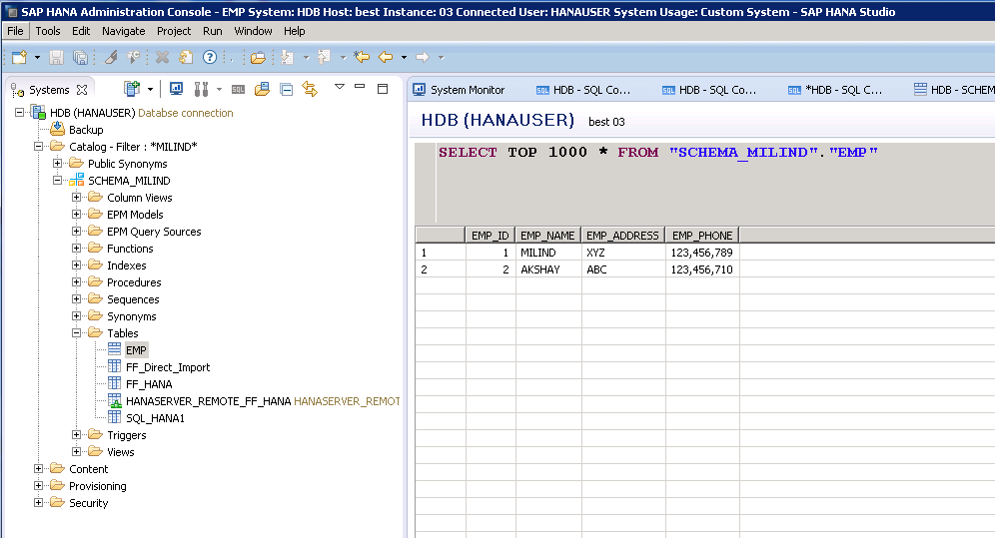
Table Content.

Slide 12
COPY TABLE
Milind Parab

Slide 13
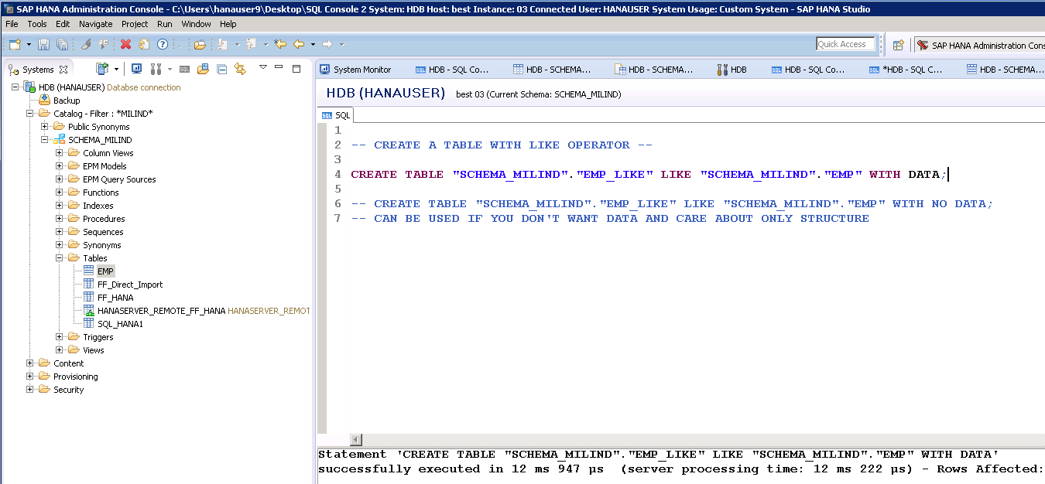
Cont.

Slide 14
Data retrival
Milind Parab

Slide 15
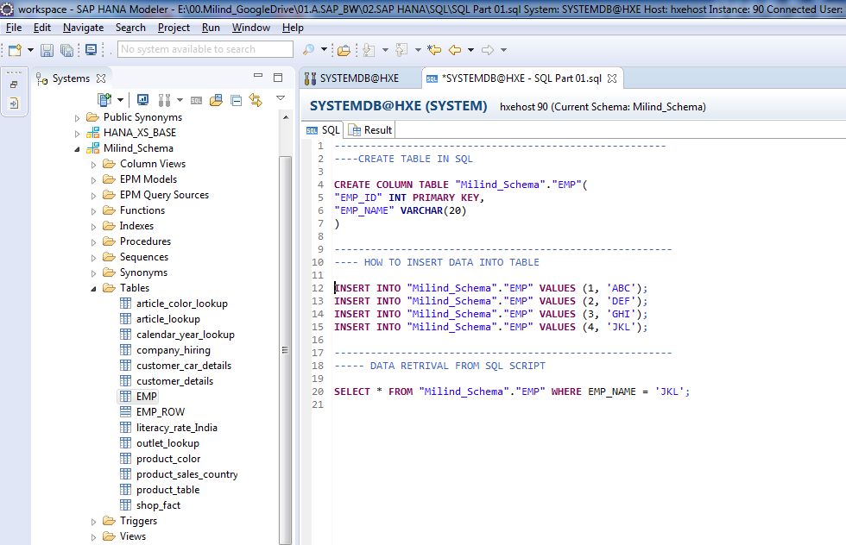
Cont.

Slide 16
COPY DATA
Milind Parab

Slide 17
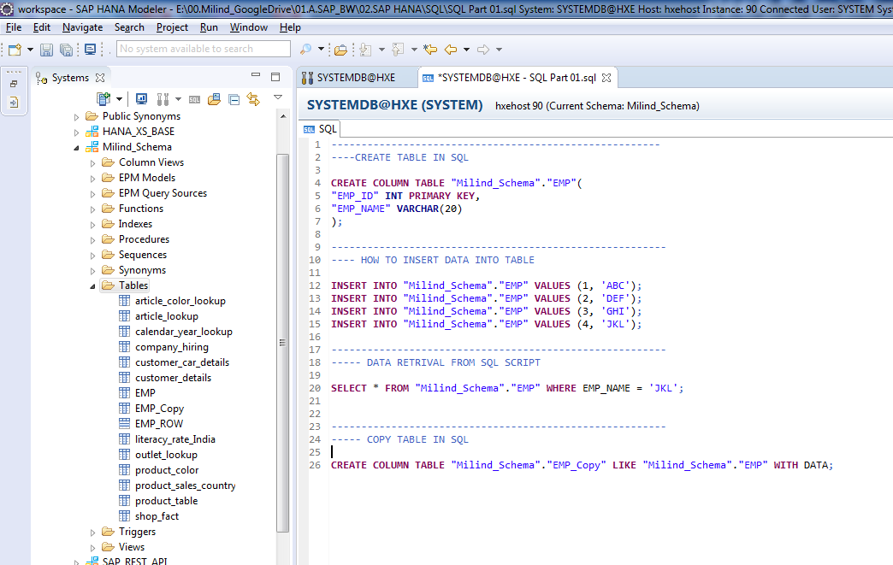
Cont.

Slide 18
COPY SPECIFIC DATA
Milind Parab

Slide 19
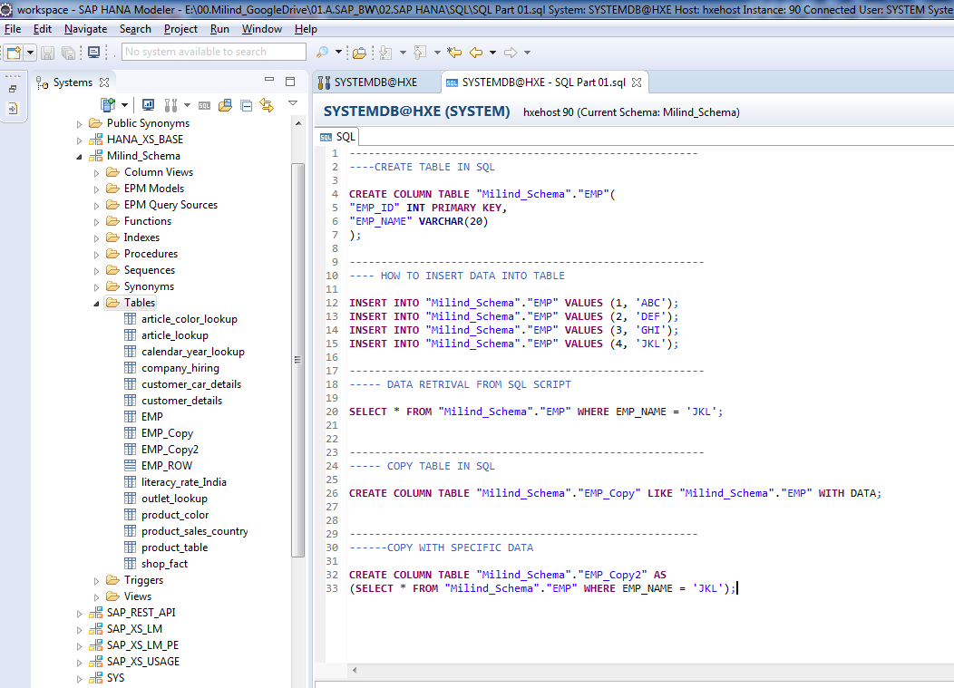
Cont.

Slide 20
COPY TABLE WITH NO DATA
Milind Parab

Slide 21
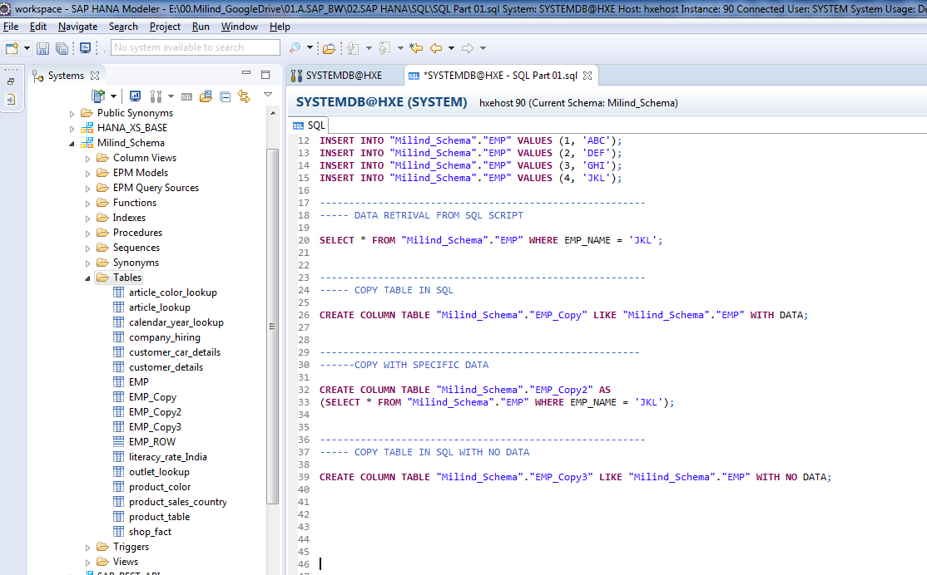

Slide 22
MULTI COLUMN PRIMARY KEY
Milind Parab

Slide 23
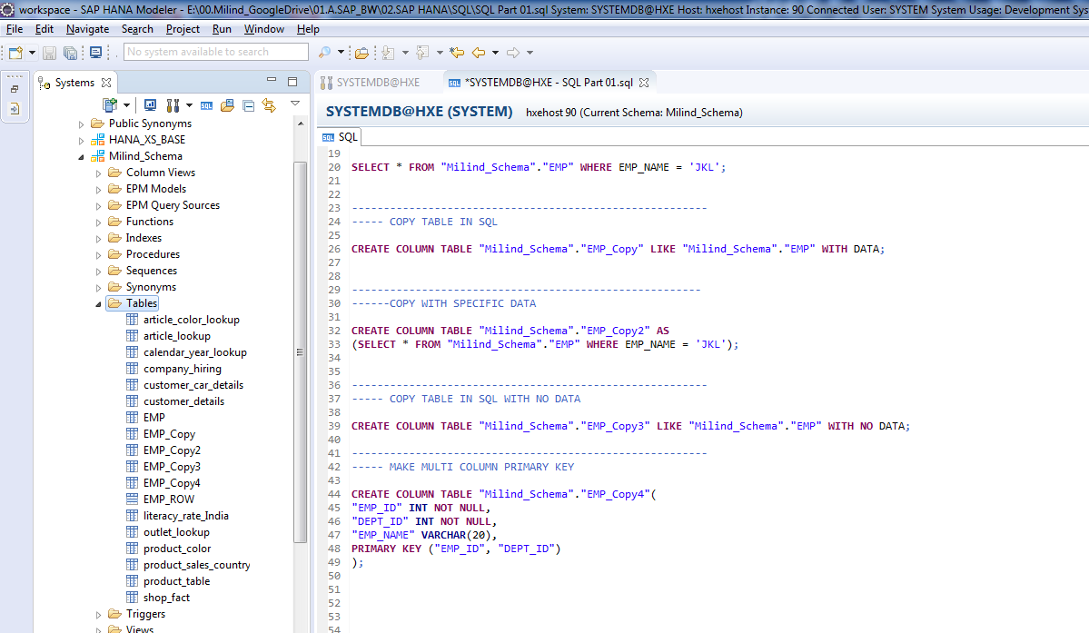

Slide 24
CREATE FOREIGN KEY
Milind Parab

Slide 25
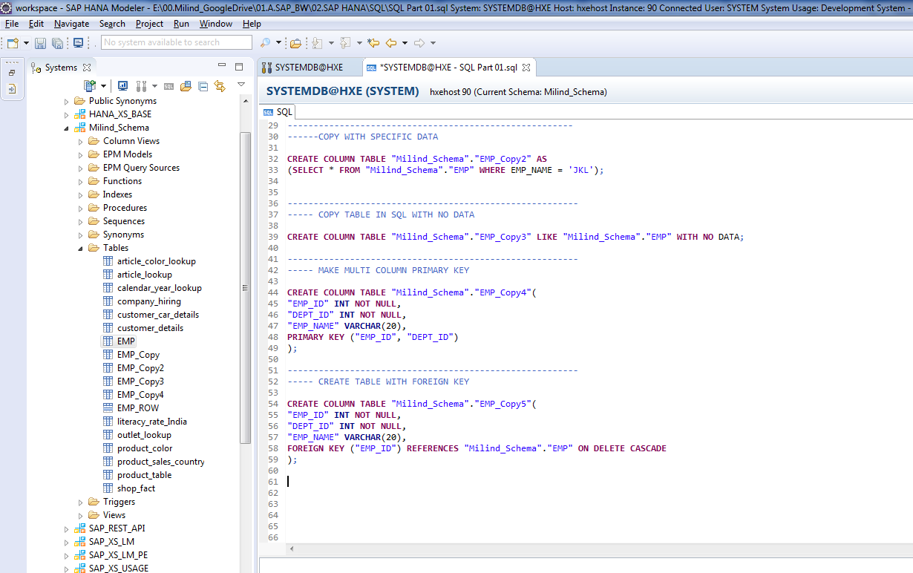
Create Foreign Key.

Slide 26
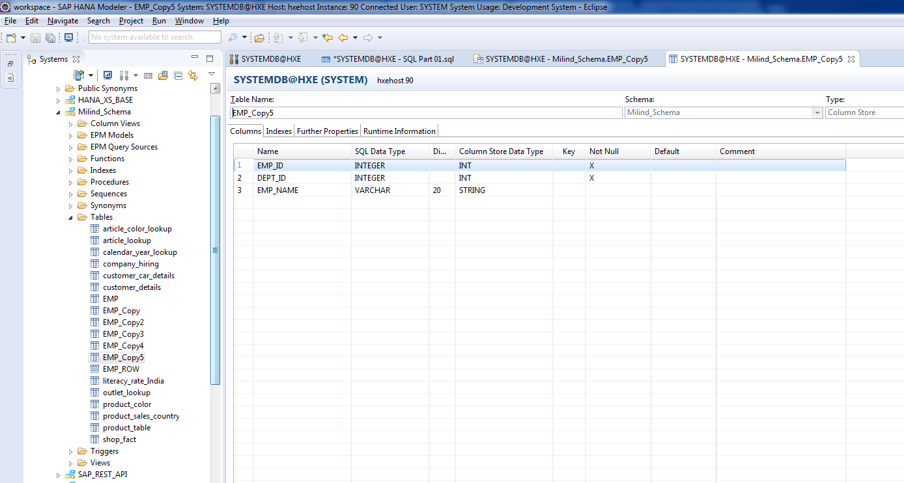
Table definition.

